Slide 1
Grammatical Facial Expression recognition using Machine Learning
Teammates
Shubhabrata Mukherjee
And
Sumitra Dey

Slide 2
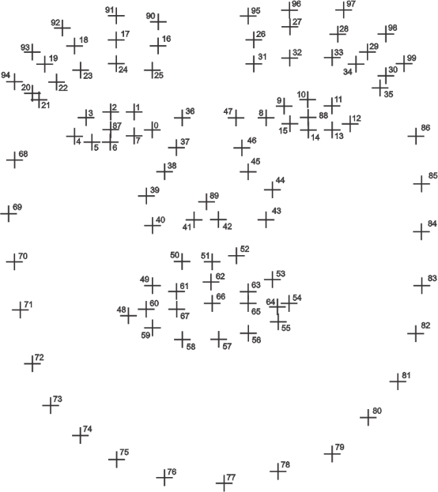
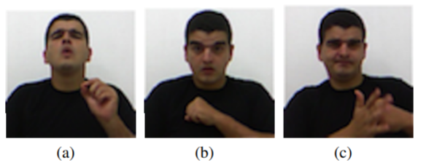
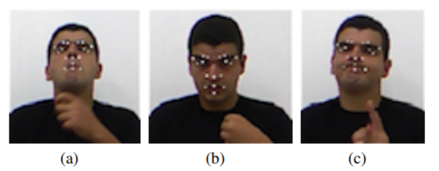
Data Representation
Microsoft KinectTMsensor⁴
FREITAS, F. A.; Peres, S. M.; Lima, C. A. M.; BARBOSA, F. V. “Grammatical Facial Expressions Recognition with Machine Learning”, Proceedings of the Twenty-Seventh International Florida Artificial Intelligence Research Society Conference.

Slide 3
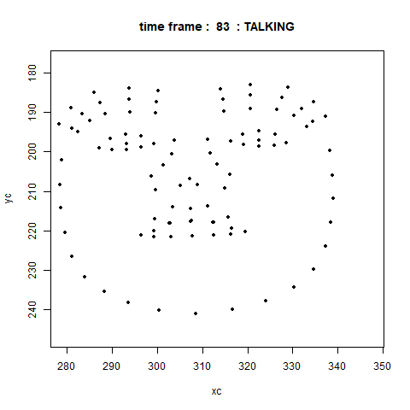
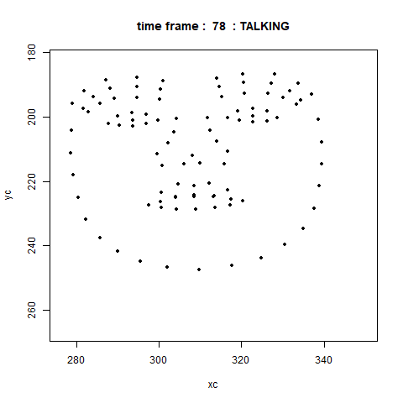
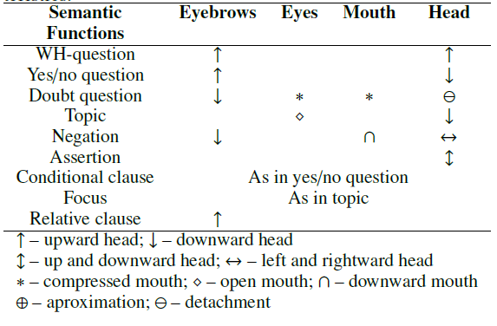
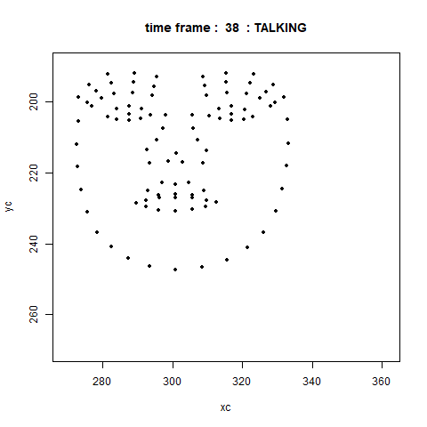
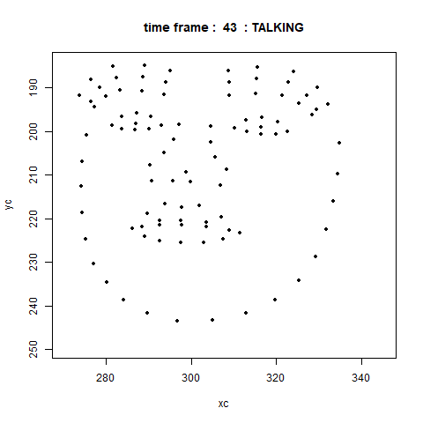
Data Interpretation
WH-Question
YN-Question
Doubt-Question
Negation

Slide 4
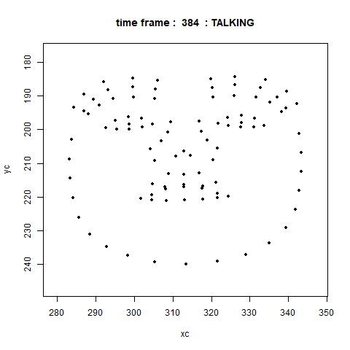

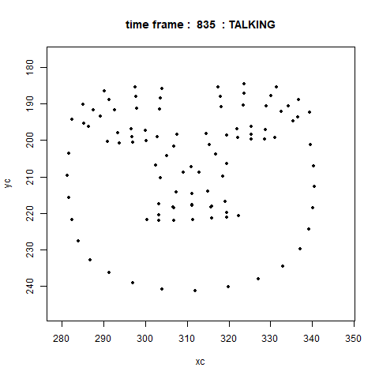
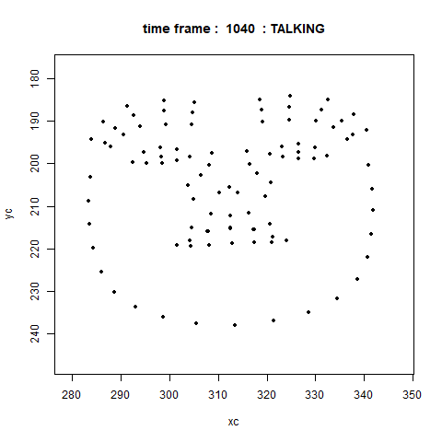
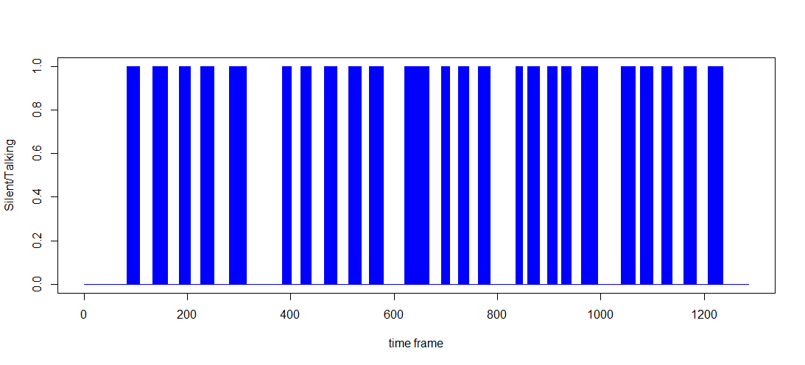
WH-Question
Silent = 0
Talking = 1

Slide 5
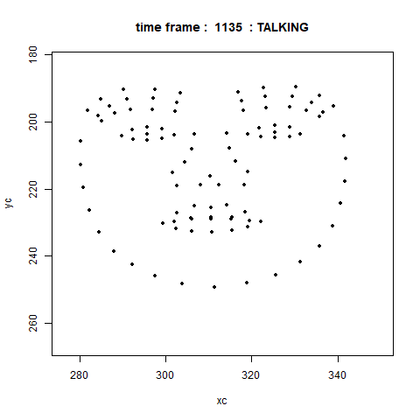
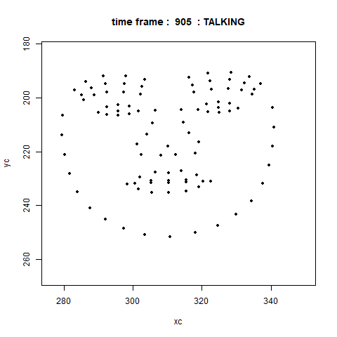
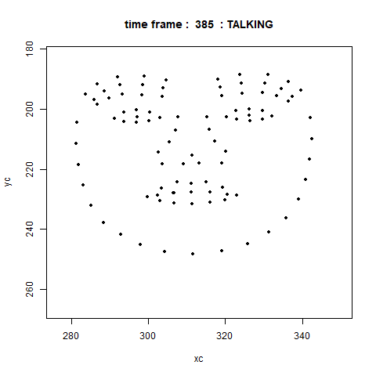
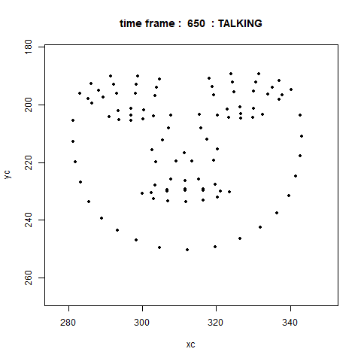
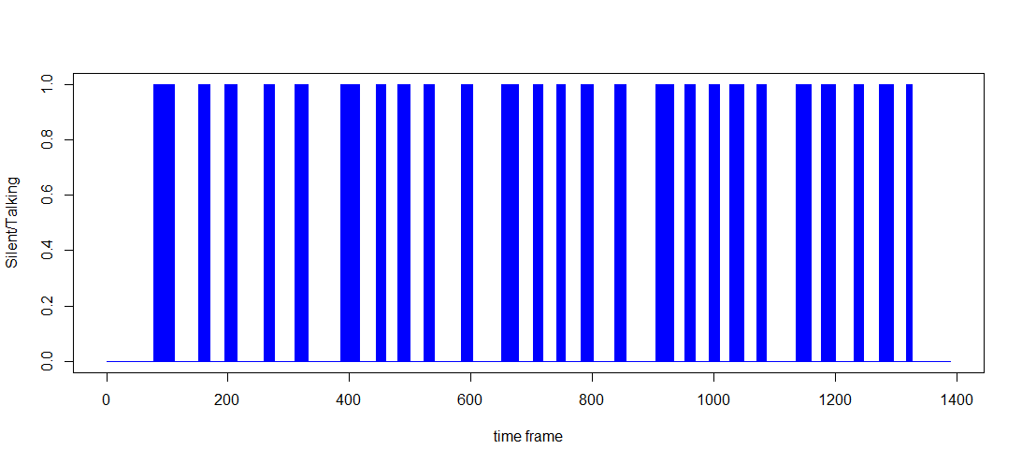
Yes-No-Question
Silent = 0
Talking = 1

Slide 6
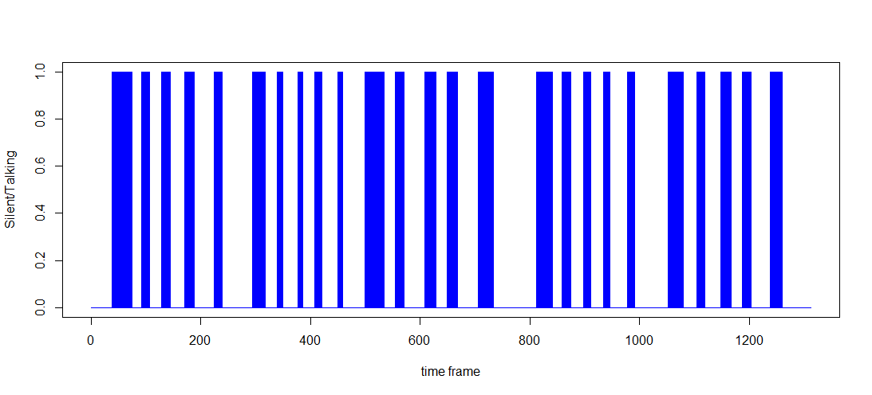
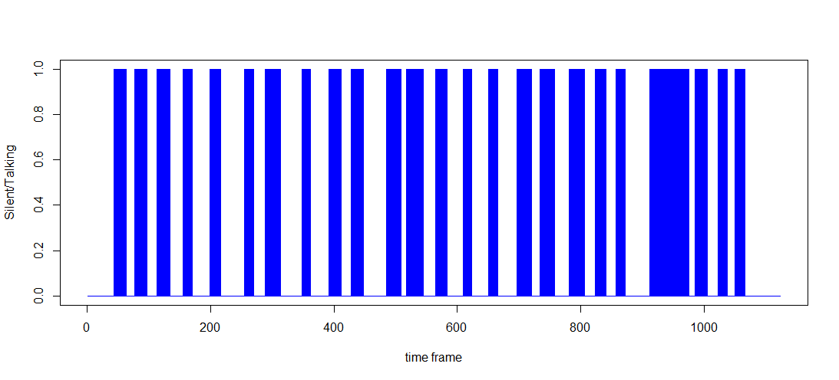
Temporal Data
WH-Question
YN-Question
Doubt-Question
Negation

Slide 7
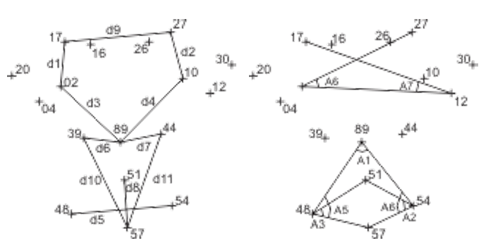
Dimension Reduction and Variable Transformation
100 points -> 300 (x,y,z) coordinates -> 17 2D points = 34 (x,y) coordinates -> 11 distance and 7 angles
Approach used in [2]: supervised neural networks, Multi-layer perception (MLP), implemented in the Matlab R Neural Toolbox.

Slide 8
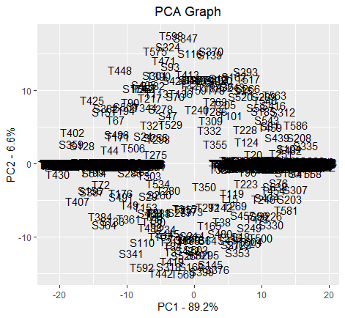
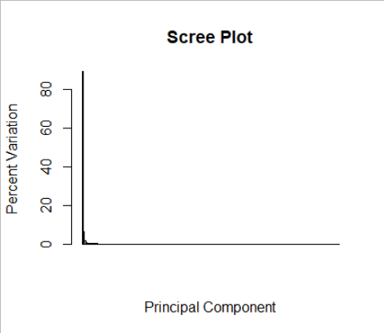
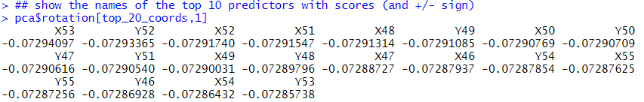
PCA on Raw Data Set (200 variables)

Slide 9
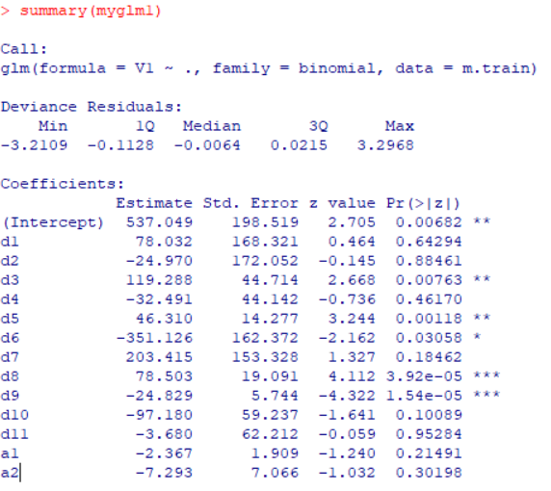
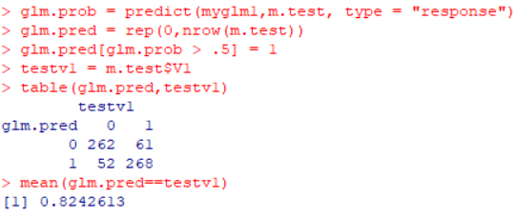
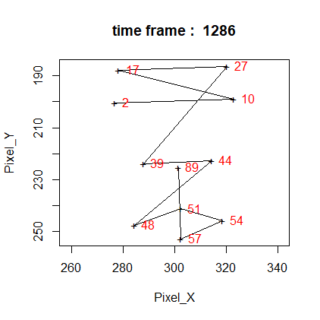
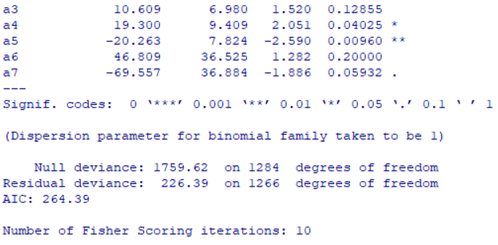
Logistic Regression :
Using 11 distance and 7 angles

Slide 10
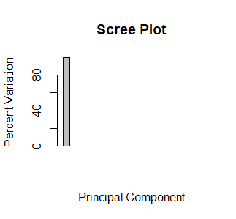
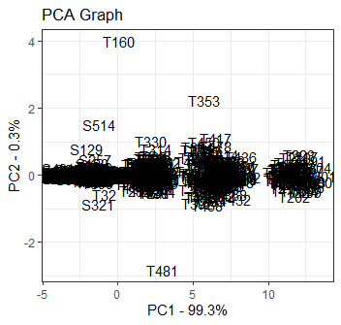
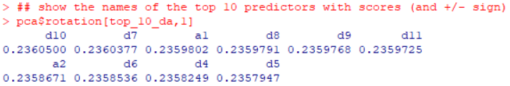
PCA on Transformed and Reduced Set of Variables

Slide 11
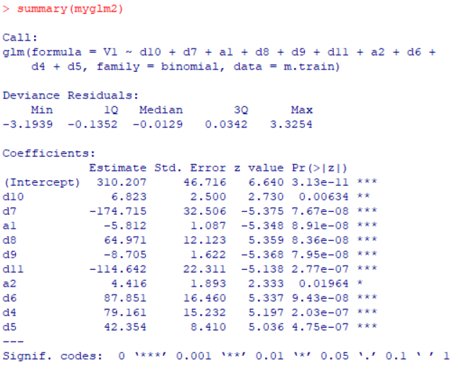
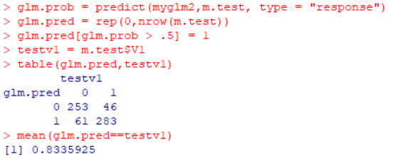
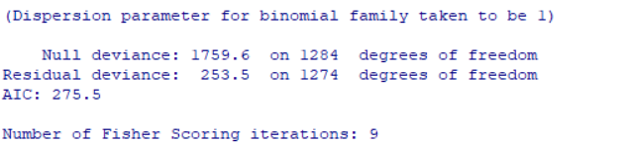
Logistic Regression :
Using 8 distance and 2 angles

Slide 12
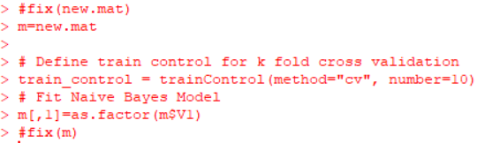
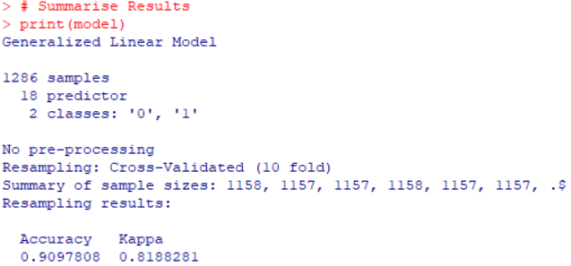
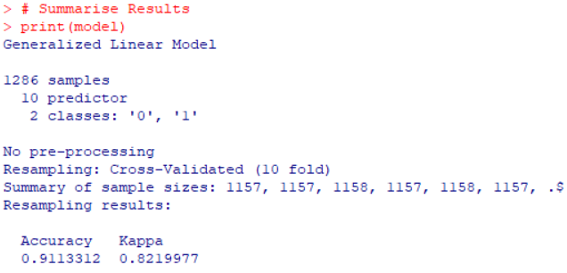
Cross-Validation
18 Variable Model
10 Variable Model

Slide 13
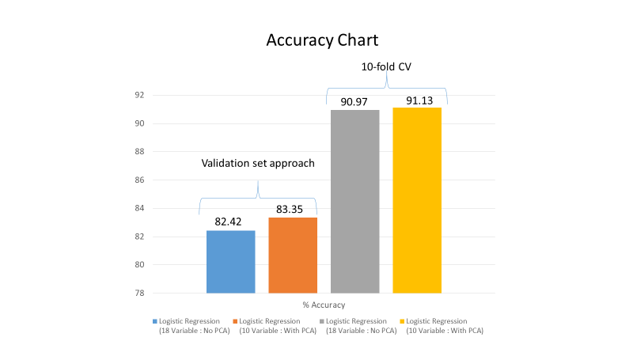
Accuracy performance

Slide 14
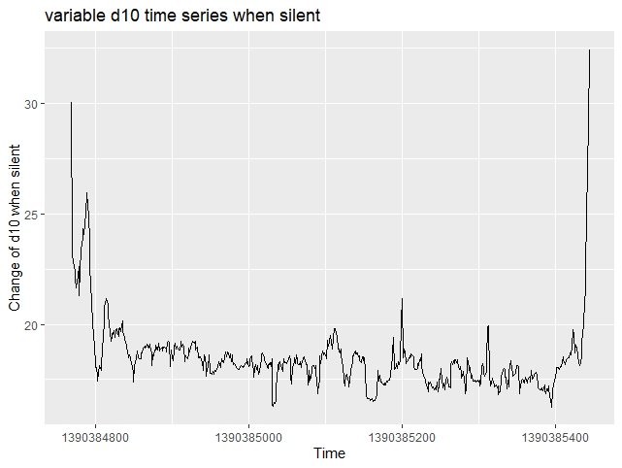
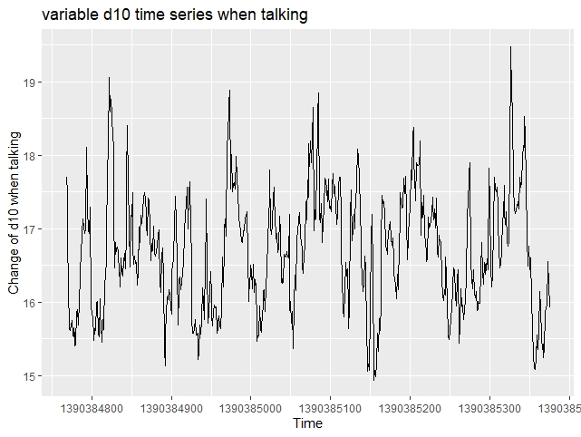
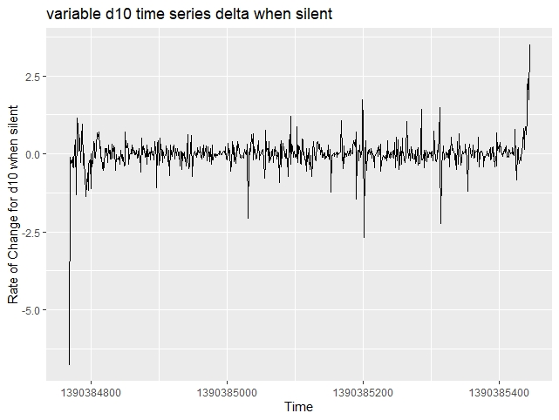
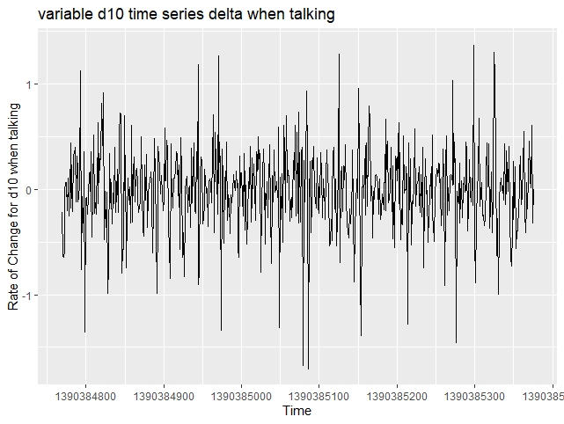
Time series analysis of d10

Slide 15


